Slide 1
Hello World
190514

Slide 2
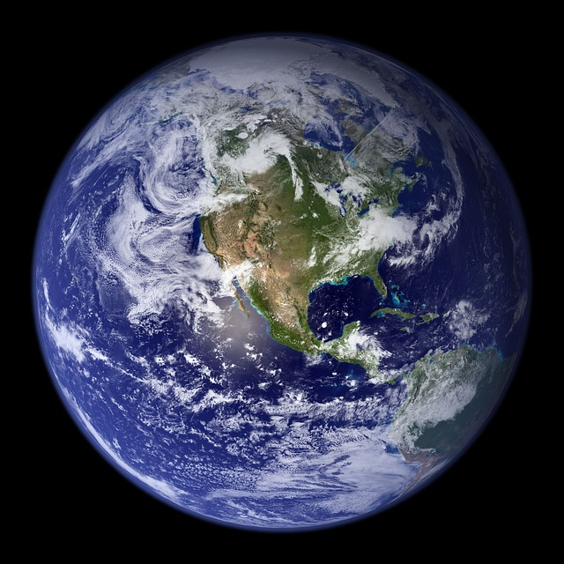
picture

